Slide 1
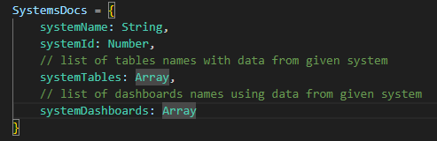
Url: /systems
Create a new system
Systems
Clicking will redirect to the url
/systems/create_new_system
Empower
Helix
Aurora

Slide 2
Url: /systems/create_new_system
Enter the system name:
Empower
Enter a name of the DNAPROD database where data from the system is stored:
Stage
Enter a name of the DNAPROD schema where data from the system is stored:
emp

Slide 3
Url: /systems/Empower
Table 1
Dashboard 1
Table 2
Dashboard 2
.
.
.
.
.
.
.
.
Table n - 1
Dashboard m - 1
Table n
Dashboard m
Clicking on a table redirects to
the url /tables_docs/table_id/table
Clicking on a dashboard redirects to
the url /dashboards/dashboard_id

Slide 4
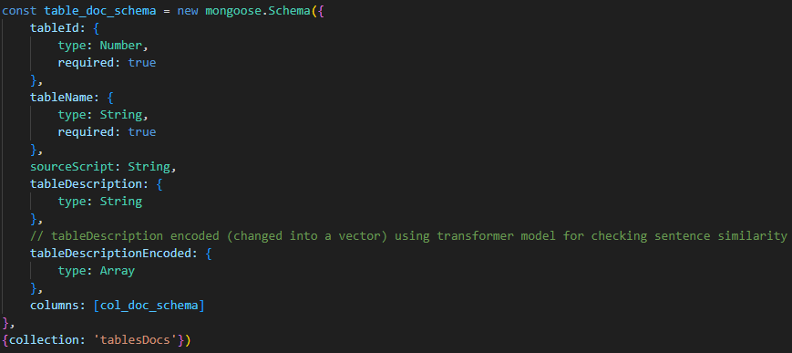
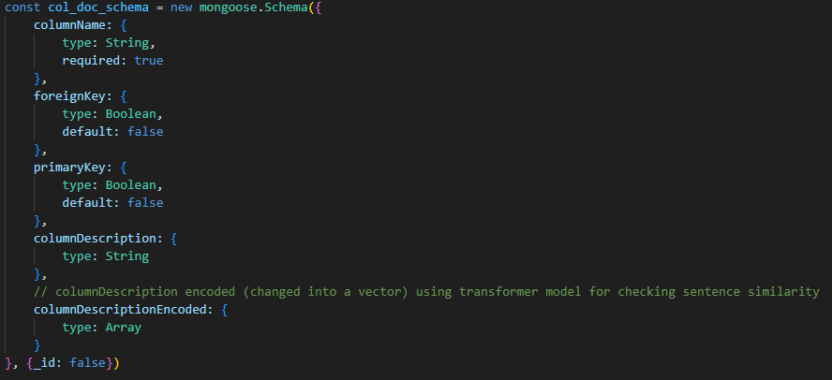
Url: /tables/table_id/table
Table 1
Table 2
.
.
.
.
Table description:

Slide 5
Url: /tables/table_id/columns
Table 1
Table 2
.
.
.
.
Column
Foreign key
Primary key
Description
Column 1
yes
no
…
Column 2
no
yes
…
.
.
.
Column 3
no
no
…

Slide 6
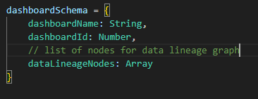
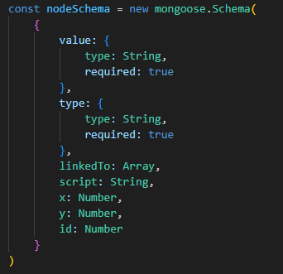
Url: /dashboards/dashboard_id
Dashboard 1
Dashboard 2
.
.
.
.
Dashboard description:
Check data lineage
Clicking redirects to the url
/dashboards/dashboard_id/data_lineage

Slide 7
Url: /dashboards/dashboard_id/data_lineage
Table 1
script
Table 1
Table n
.
.
script
Cube table 1
script
Table n
Table 1
script
Table 1
Table n
.
.
script
Cube table 2
script
Table n

